Slide 1







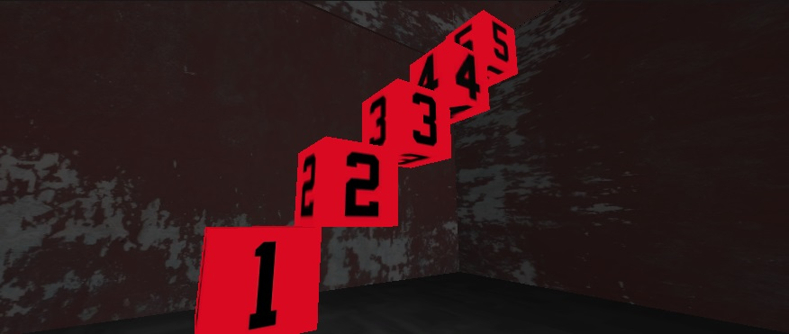
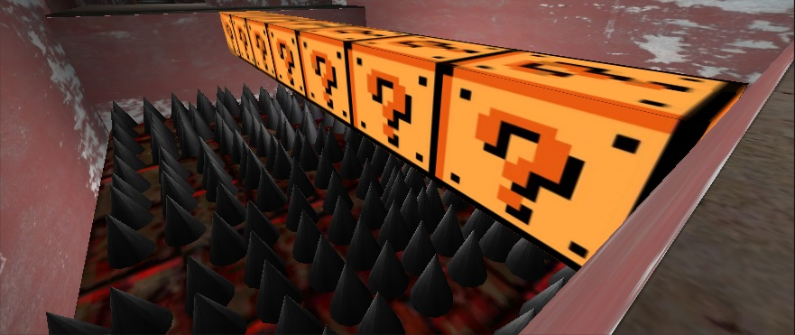
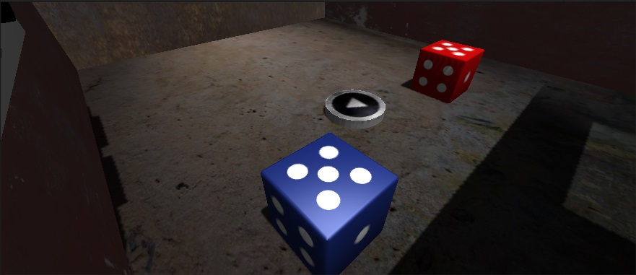
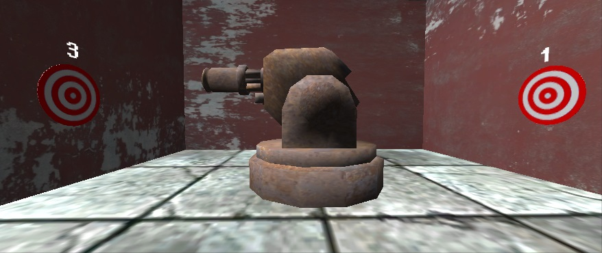

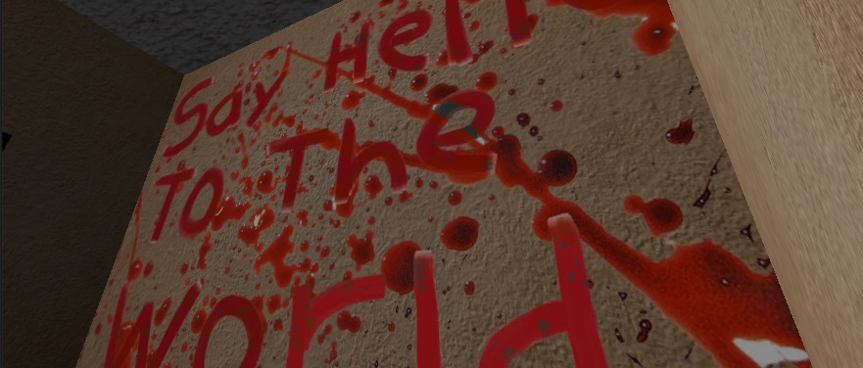
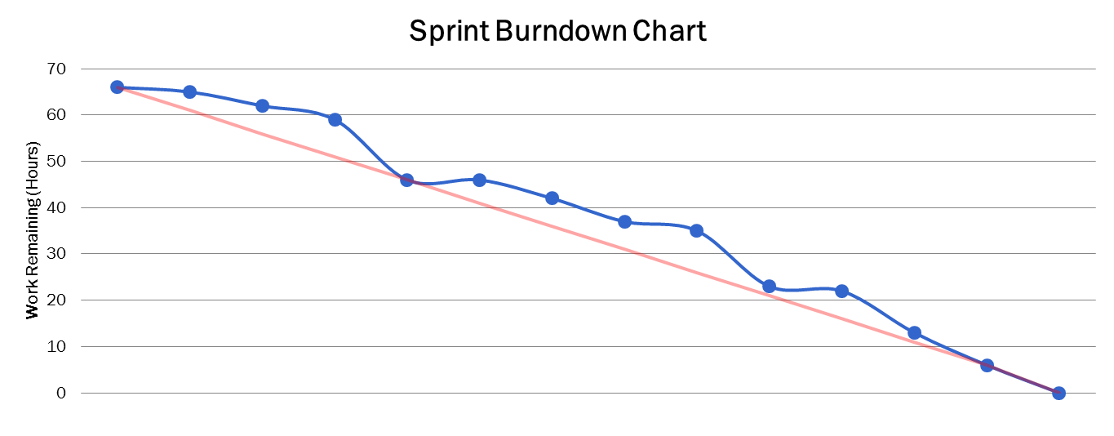
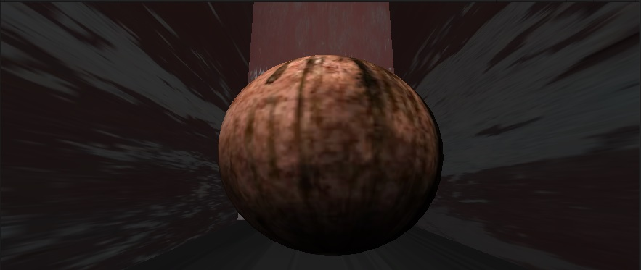
CodeEscape
The funner way to learn Java
Team Members: Dani Odicho, Tariq Rafiq, Ernie Ledesma, Oscar Lugo, Jose Pech, Kasun Hettiarachchi , Abel Lawal, Joseph Pena
ABSTRACT
MOTIVATION
DEVELOPMENT TOOLS
The main goal of the CodeEscape project was to make programming accessible and attractive to a broader audience. A younger audience does not yet possess the logical and analytical skills required to fully grasp the fundamentals of programming which makes programming and the discipline of computer science unappealing.
CodeEscape is a fun but challenging way to introduce the basic concepts of programming to this audience. Lessons are embedded in a scary and engaging world consisting of 10 levels. The player must advance through each, a locked room that can only be opened by programmatically solving the room’s puzzle, The player “Jacks In” to the console object in order to obtain instructions and hints, but most importantly view and interact with Java source code. They will learn everything from the simple “Hello World” program, to more advanced and theoretical concepts such as Object Oriented Programming. The game also focuses on the intangible elements of coding such as nomenclature and indentation amongst others, all key elements of good style. CodeEscape provides a new and interesting way to bring awareness of the true nature of programming to a completely different audience, and hopefully in time, inspire the next generation of developers.
Inspire the next generation of developers:
The creation of CodeEscape required the utilization of a variety of different tools:
3D game engine: Used to do the heavy lifting of the game creation.
To provide the right aesthetic look to the game, including textures, model, and animation.
Used to create the scripts and as a general IDE.
Used as source control mechanisms.
CodeEscape makes the world of programming appealing to a broader audience. It is an informal way to learn the formal rules of programming.
Group Motivation
Our desire to provide a fun learning experience that vastly differs from the texts and tutorials that are so often found as introductions to programming.
THE GAME
SOFTWARE ENGINEERING PROCESS
CONCLUSION
These are screen shots highlighting some of the elements found in the game. All of these elements either add to the “horror code” theme of the game. Or they are part of puzzles each used to illustrate a different aspect of coding fundamentals.
Agile Methodology
CodeEscape is a fully functional game, with 10 unique fully playable levels. Each level introduces and explains a different programming concept.
The game is robust having being developed with a powerful game engine and is very easy to install.
The game responded well to testing and has the potential to be a teach tool or a study aid for introductory programming classes
Overall the project was a success as we fulfilled the goals that we had set at the start of the project. The project took on a life of its own as it progressed and this game has turned into more than the team ever envisioned.
Group Member Assignments
Product Owners: Dani Odicho & Ernie Ledesma Scrum Master: Tariq Rafiq
Sprint length: Two (2) weeks.
Each sprint comprised of numerous tasks.
The scrum master appointed tasks for every sprint, but early on the team decided to try and complete a level every sprint.
After the completion of every sprint the product owners would review the game and see if it aligned to the original goals of the project.
The owners’ feedback was then used to guide the development of the game.
Progress of each sprint was tracked using the MIT schedule, which allowed us to create Sprint Burndowns.
Using these burndowns we were able to monitor productivity and alter the schedule in order to make sure that the optimal progress was achieved every sprint.
FUTURE PLANS
Enhanced Artwork. The primary focus thus far has been on the functionality of the game. Though the current artwork in the game is great, there is always room for improvement
Mobile Version. The average young person is using less time on a desktop and more time on a mobile device, therefore a mobile version of this game would greatly improve its appeal to the younger audience.
Expanded Concepts & Levels. Additional levels could cover intermediate to advanced concepts .

